Slide 1

https://datalytiqsacademy.com/

Slide 2
CPA FOUNDATION LEVEL
CIFA FOUNDATION LEVEL
ECONOMICS
a Presentation by:
Collins Odhiambo owino-DATALYTIQS ACADEMY.

Slide 3
1. Observation and Identification of the Problem
Economists begin by observing real-world economic events and identifying a specific issue that needs to be studied.
Examples:
Rising unemployment
Increasing food prices
Low agricultural productivity
Currency depreciation
The purpose is to clearly define what economic phenomenon requires explanation.

Slide 4
2. Formulation of a Hypothesis
A hypothesis is a logical, testable statement that attempts to explain the observed problem.
In economics, it proposes a relationship between variables.
Examples:
“An increase in interest rates reduces consumer borrowing.”
“Higher taxes reduce disposable income and household consumption.”
The purpose is to provide a guiding idea that can be tested empirically.

Slide 5
3. Data Collection and Testing the Hypothesis
Economists gather relevant data, either from:
Surveys
Government statistics
Market data
Experiments (rare in economics)
They then use economic models, graphs, and statistical tools to test whether the data supports or rejects the hypothesis.
Example:
Using regression analysis to check whether higher interest rates actually reduce borrowing.
To determine if the hypothesis is consistent with real-world evidence.

Slide 6
4. Conclusion, Evaluation, and Theory Development
After testing, economists draw conclusions:
If data supports the hypothesis → it becomes part of economic theory.
If data does not support it → the hypothesis is rejected or modified.
Economists also evaluate:
The reliability of data
Limitations of the study
Whether the findings can predict future outcomes
The purpose is to build or refine economic theories and inform economic policy decisions.

Slide 7
Government Strategies to Counter Climate Change Effects on Agriculture
1. Promotion of Drought-Resistant and Early-Maturing Crop Varieties
The government can fund research and distribute seeds that tolerate drought, heat, and irregular rainfall. This helps farmers maintain yields despite harsh conditions.
2. Expansion of Irrigation Infrastructure
Developing dams, boreholes, canals, and drip-irrigation schemes reduces dependence on unreliable rainfall and ensures continuous water supply to crops.
3. Soil and Water Conservation Measures
Strategies such as terracing, mulching, agroforestry, water harvesting, and conservation tillage help retain soil moisture, reduce erosion, and maintain soil fertility.

Slide 8
Government Strategies to Counter Climate Change Effects on Agriculture(continued)
4. Strengthening Weather Forecasting and Early-Warning Systems
Providing accurate, timely climate information enables farmers to plan planting, harvesting, and input use according to expected conditions, reducing risks.
5. Subsidies and Financial Support to Farmers
Offering crop insurance, input subsidies, credit facilities, and compensation during extreme weather events helps farmers recover and adapt to climate shocks.
6. Reforestation and Environmental Protection Policies
Planting trees, protecting water catchments, and regulating deforestation improve rainfall patterns, reduce flooding, and stabilize ecosystems crucial for farming.

Slide 9
Meaning of “Central Bank”
A central bank is the main financial institution of a country responsible for issuing currency, regulating the financial system, and implementing monetary policy on behalf of the government. It oversees commercial banks and ensures economic and financial stability.

Slide 10
FOUR Secondary Functions of a Central Bank
1. Banker to Commercial Banks
It holds accounts for commercial banks, clears cheques, and provides loans to them.
2. Banker, Financial Adviser, and Agent to the Government
It manages government accounts, advises on financial matters, and facilitates public debt operations.
3. Custodian of Foreign Exchange Reserves
It holds and manages a country’s foreign currency reserves and stabilizes the exchange rate.

Slide 11
…
4. Controller of Credit
It influences the level of credit in the economy through tools like interest rates and open-market operations.

Slide 12
FOUR Limitations of the Production Possibility Frontier (PPF)
1. It Assumes Only Two Goods
The PPF simplifies reality by analyzing the production of only two goods, yet real economies produce thousands of goods and services.
2. It Assumes Fixed Resources and Technology
The model assumes that resources and technology remain constant, which is unrealistic since both change over time.
3. It Does Not Show Distribution of Output
The PPF shows what an economy can produce, but not who receives or benefits from the goods produced.

Slide 13
…
4. It Does Not Account for Unemployment or Underutilization
The PPF assumes full and efficient use of resources. In real economies, unemployment and idle resources often exist.

Slide 14
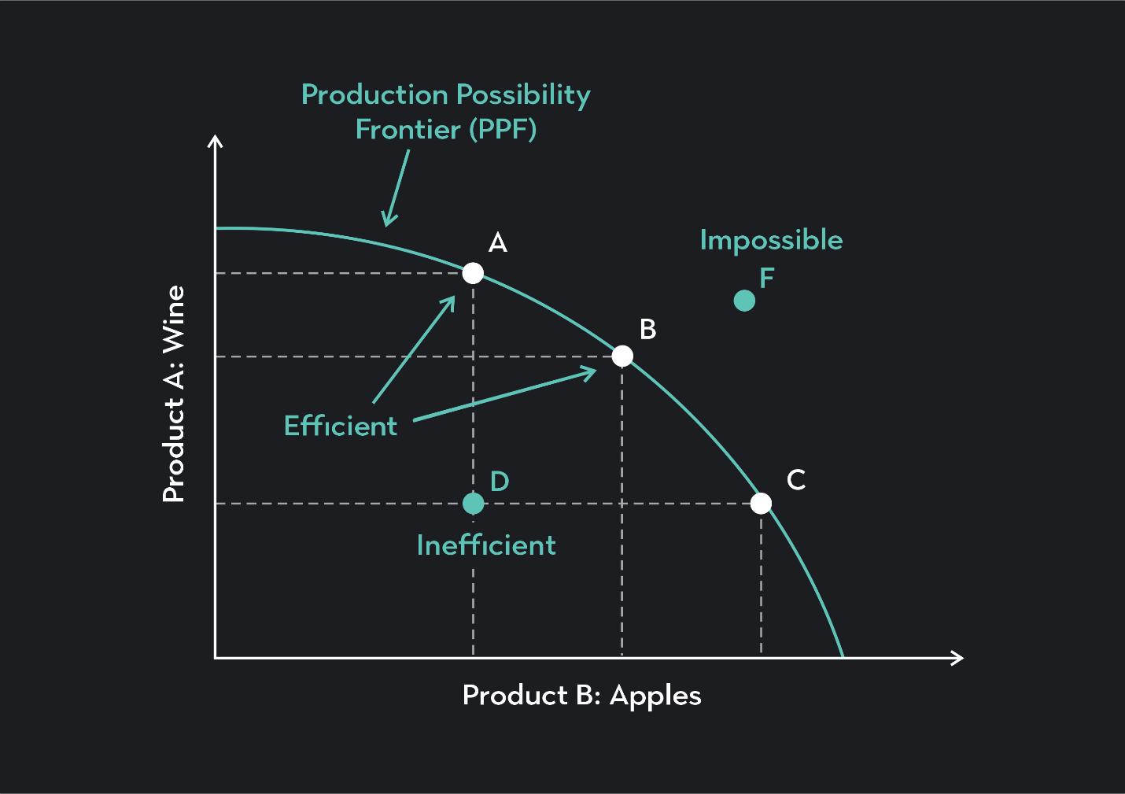
The Production Possibility Frontier (PPF)

Slide 15
https://datalytiqsacademy.com/courses/cpa-economicskasneb/
          THANK YOU

